Slide 1
Haslemere Vision
A: What do you like about Haslemere?

Slide 2
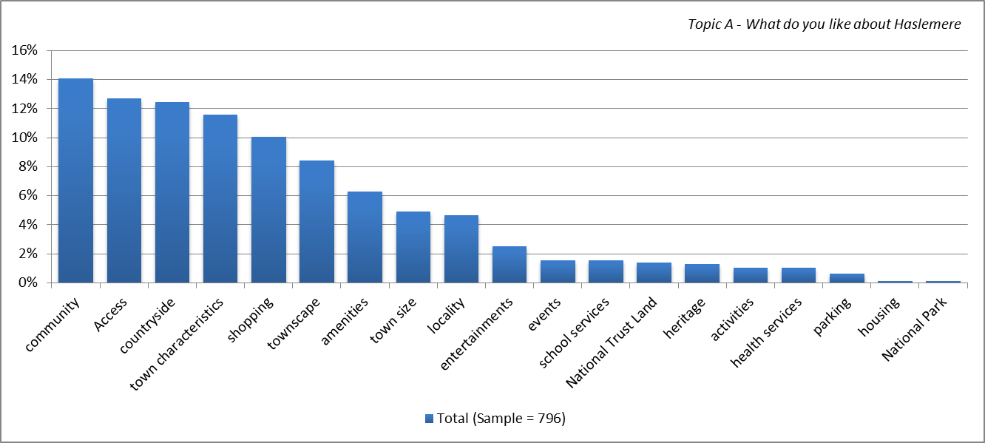
Main topics for all respondents

Slide 3
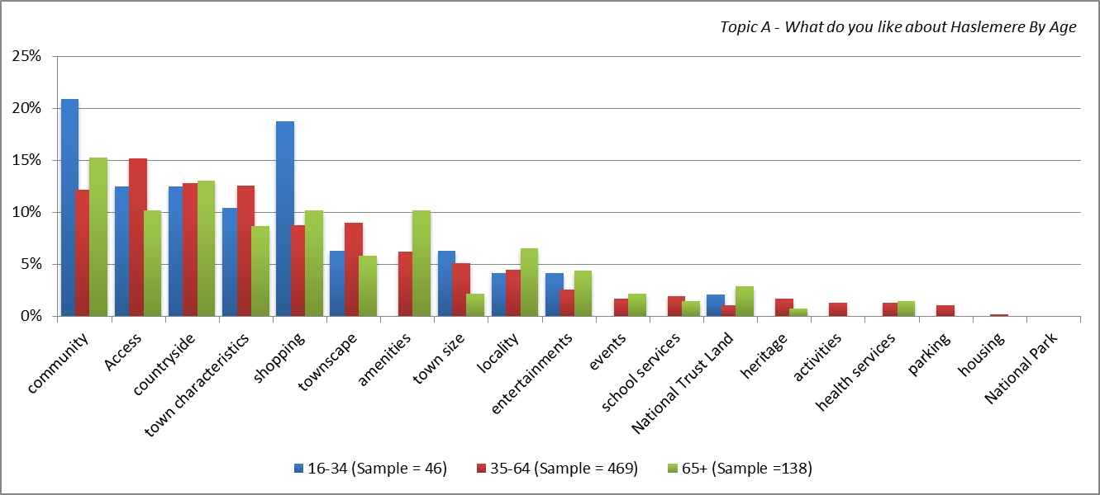
Main topics by age

Slide 4
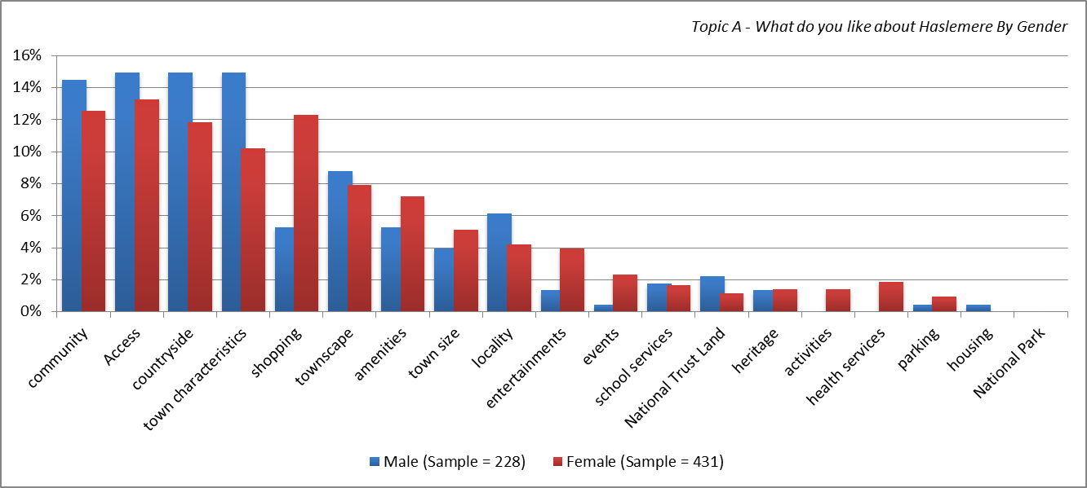
Main topics by gender

Slide 5
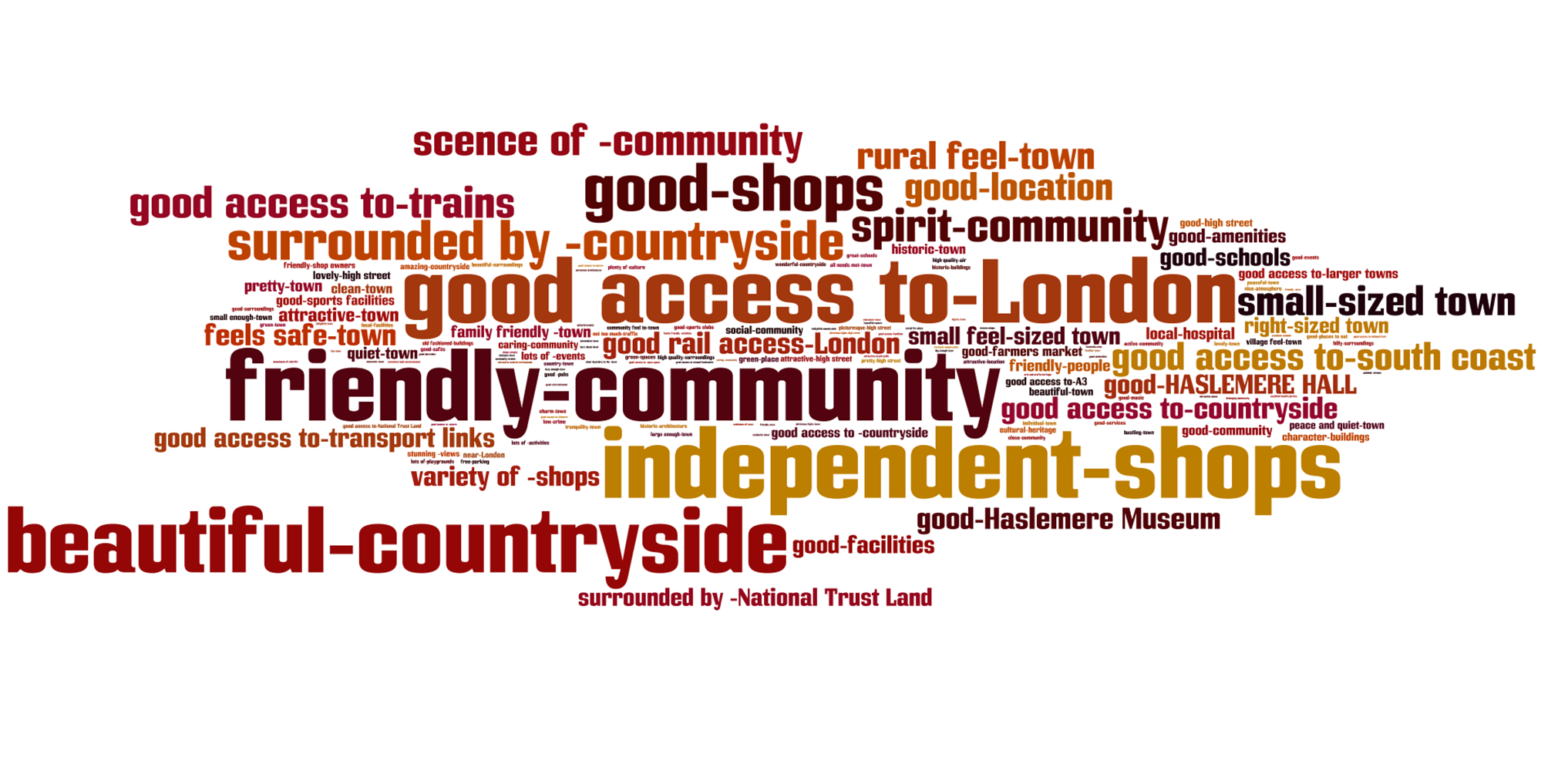
All respondents (sample – 796)

Slide 6
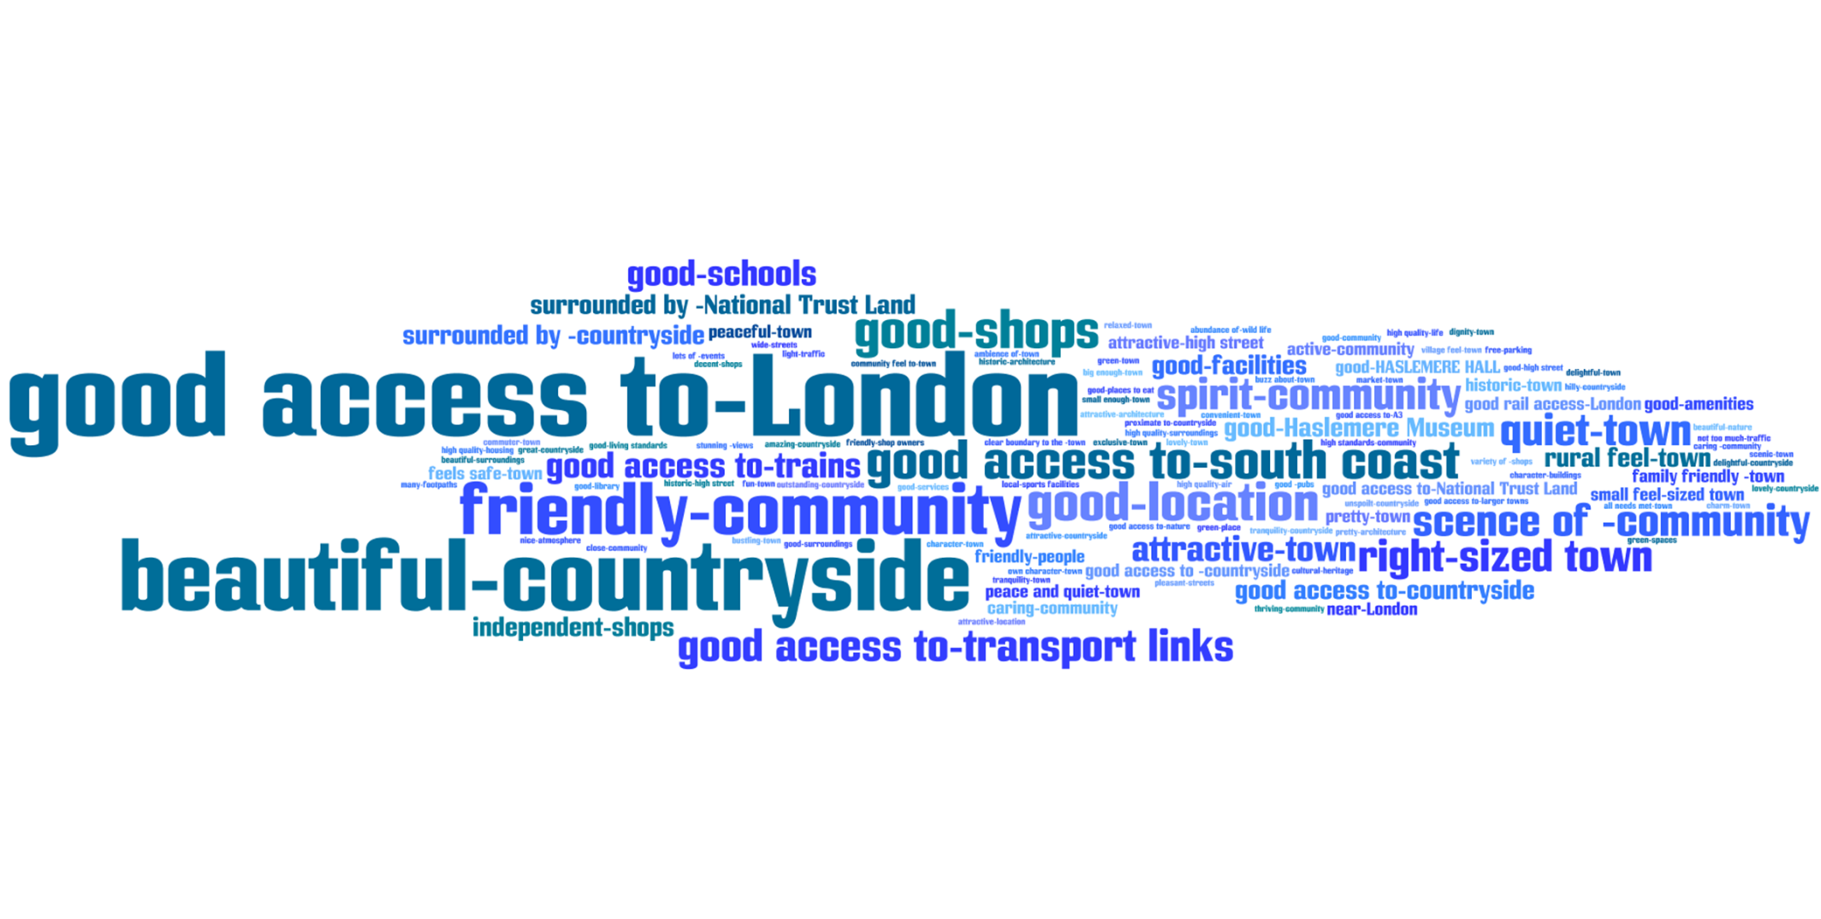
Male respondents (Sample – 228)

Slide 7
Female respondents (Sample – 431)

Slide 8
Respondents aged 16-34 (Sample – 46)

Slide 9
Respondents aged 35-64 (Sample – 469)

Slide 10
Respondents 65+ (Sample – 138)

Slide 11
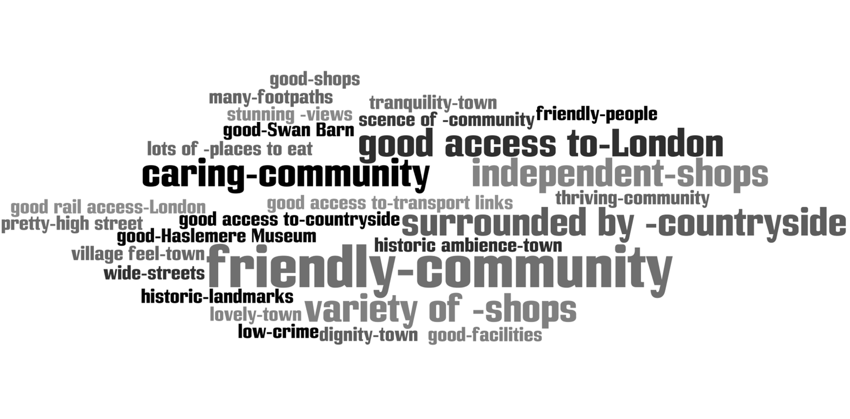
Respondents with a disability (Sample – 36)

