Slide 1
Haslemere Vision
Topic B -issues for the Neighbourhood Plan

Slide 2
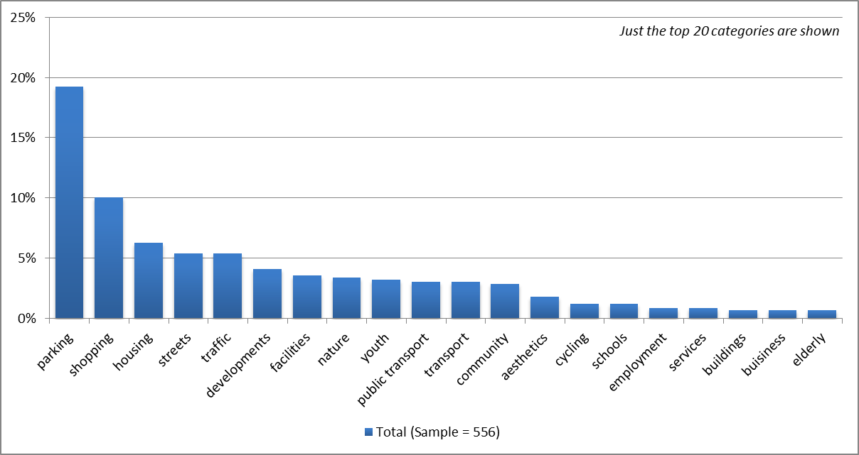
What are the issues you think could be addressed by a Neighbourhood Plan for Haslemere and surrounding villages: Main topics for all respondents

Slide 3
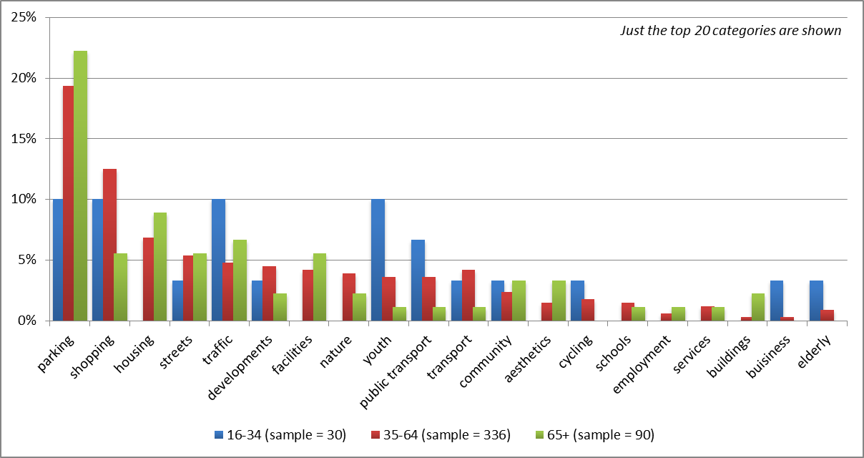
Main topics by age

Slide 4
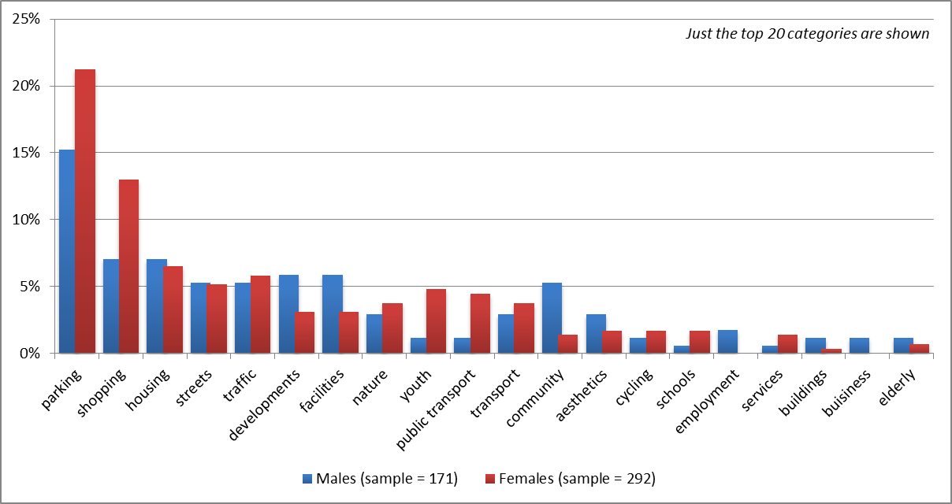
Main topics by gender

Slide 5
All respondents (sample – 512)

Slide 6
Male respondents (Sample – 161)

Slide 7
Female respondents (Sample – 283)

Slide 8
Respondents aged 16-34 (Sample – 27)

Slide 9
Respondents aged 35-64 (Sample – 327)

Slide 10
Respondents 65+ (Sample – 82)

Slide 11
Respondents with a disability (Sample – 22)

