Slide 1
Haslemere Vision
D: Changes to Haslemere

Slide 2
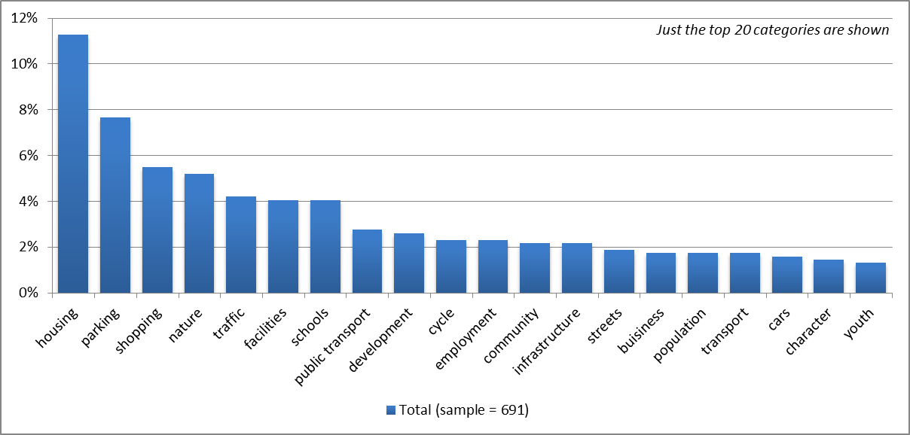
Changes to Haslemere in next 5-20 years: Main topics for all respondents

Slide 3
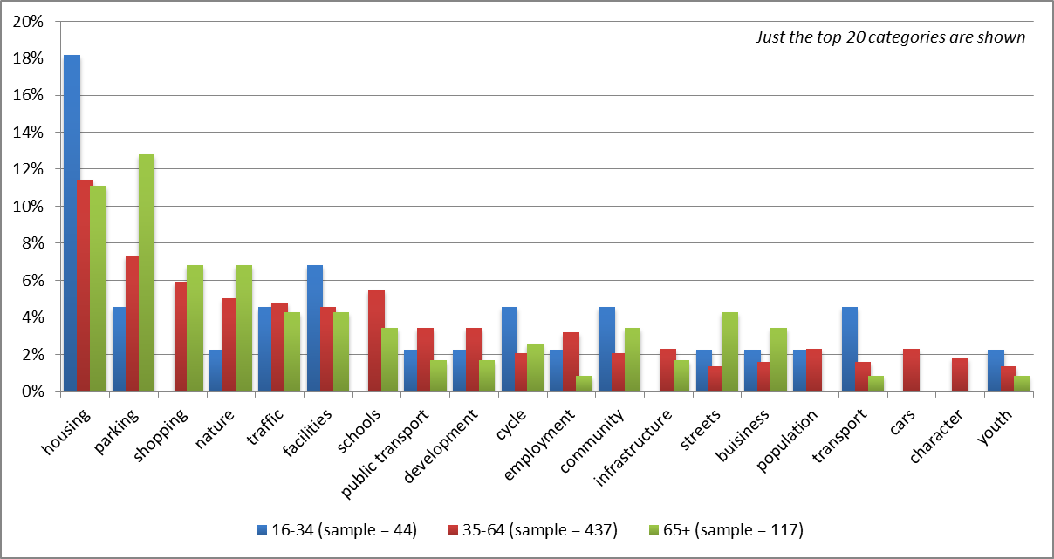
Main topics by age

Slide 4
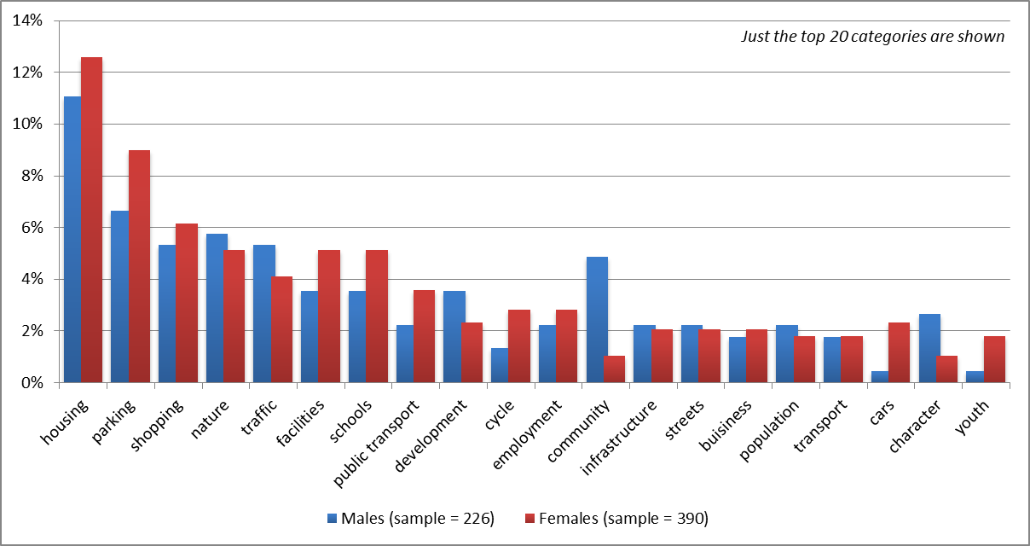
Main topics by gender

Slide 5
All respondents

Slide 6
Male respondents

Slide 7
Female respondents

Slide 8
Respondents aged 16-34

Slide 9
Respondents aged 35-64

Slide 10
Respondents 65+

Slide 11
Respondents with a disability

