Slide 1
Draft Consultation Feedback

Slide 2
The Profile of Response
248 Questionnaires returned to date
56 incomplete
192 complete responses
Haslemere 2011 population
East 6553
West 5981
Hindhead 4292
All 20,826
3,248 of these residents are under 15
17,578 leaving adults
a response rate of 1.1%

Slide 3
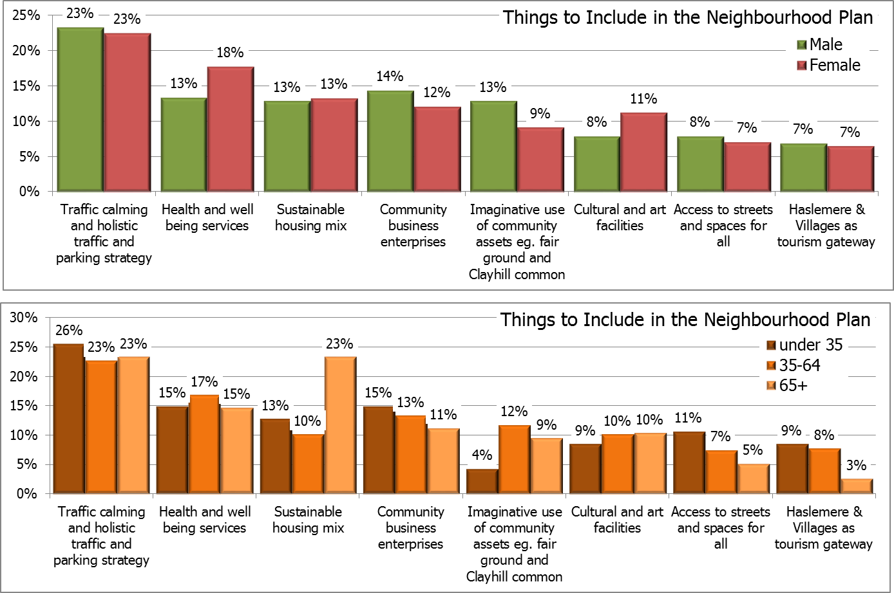
Things to Include in the Neighbourhood Plan
Choose up to three of the following items you think are the most important for
inclusion in the neighbourhood plan.

Slide 4
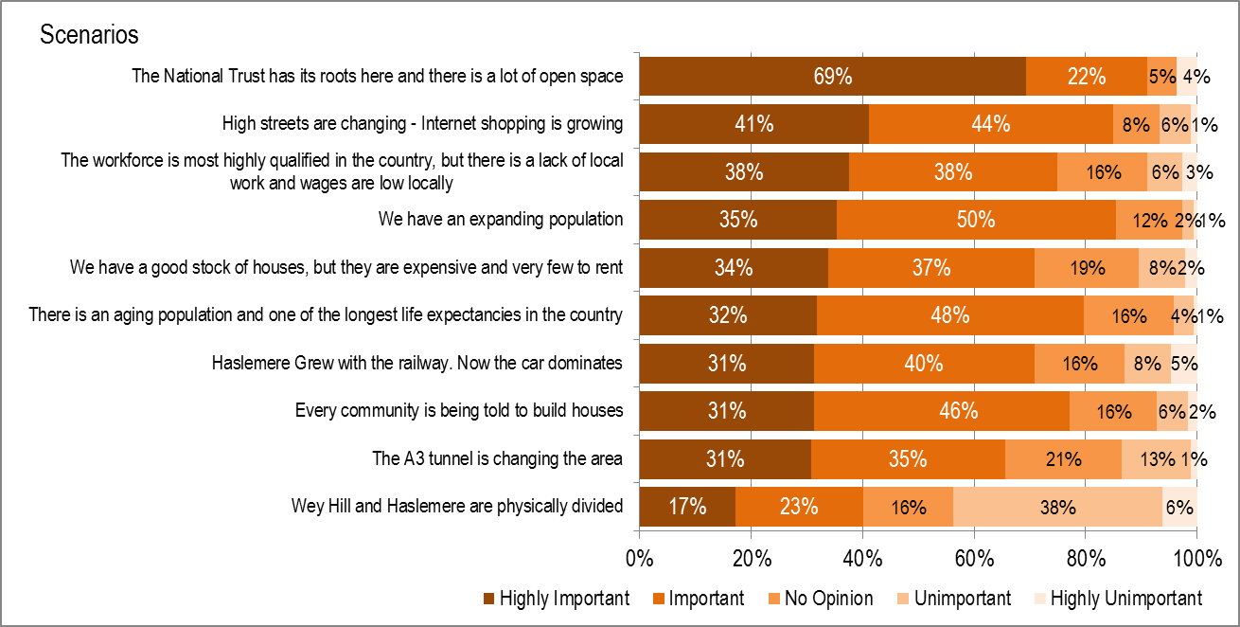
Scenarios
Please rate these scenarios for how important you think they are for the future of
Haslemere and surrounding villages.

Slide 5
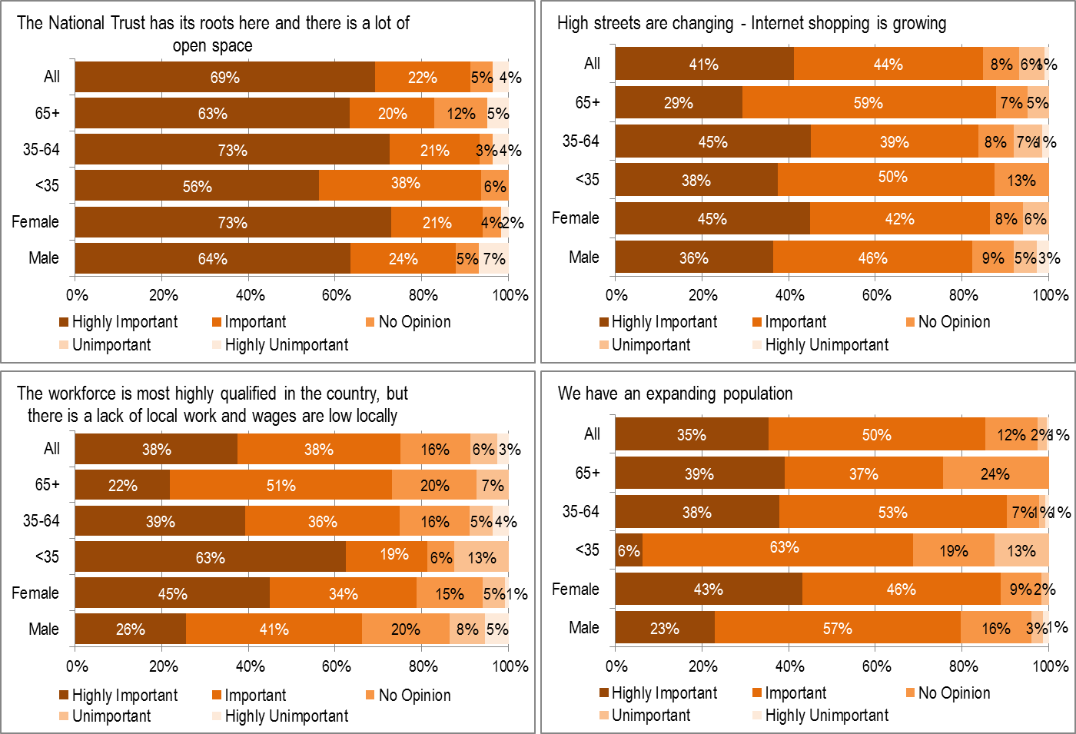
Scenarios in detail

Slide 6
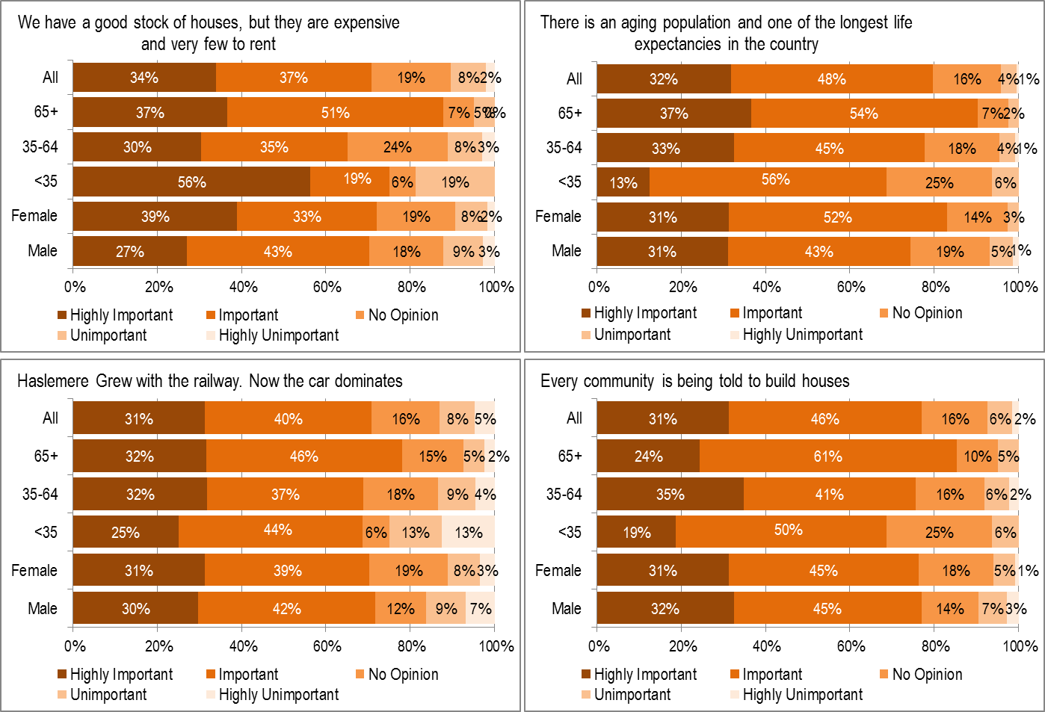
Scenarios in detail

Slide 7
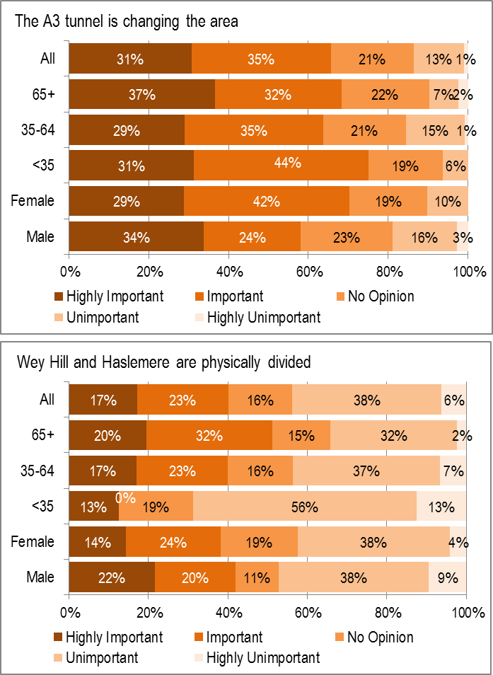
Scenarios in detail

