Slide 1

Phase1 Consultation Results
23rd September 2014

Slide 2
Phase 1 Consultation
The Phase 1 Consultation took place during the summer
  We used royal mail to distribute to all homes in post codes GU27 1 and GU27 2.
  Others in surrounding settlements like Camelsdale were invited to take part
  In addition the consultation document and questionnaire were available online
There has been considerable comment on the consultation,
  We all accept that it was a long document and the issues sometimes complex
  It was anticipated that some people would be put off by its length
  It was agreed that the options warranted full explanation
We should bear in mind
  WBC consultations have received far less response
  Commercial online surveys that people are paid to complete often receive less than 10% response
What we now have is a sound basis for the development of the Neighbourhood Plan in these areas
We will be able to focus the shorter phase II consultation on housing related issues

Slide 3
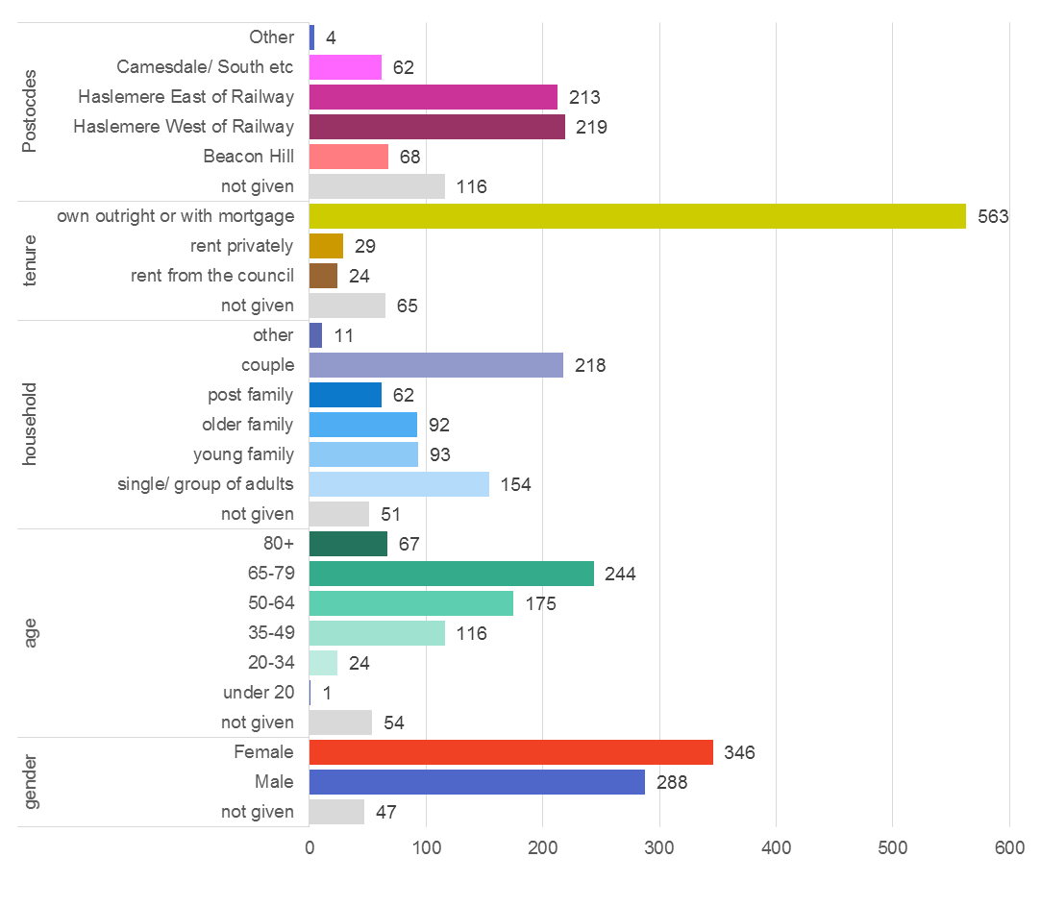
Who Participated
We have received 681 responses
A good balance of genders
Low participation from the under 35s
A good cross section of households
More home owners
Good geographical distribution
The results presented below are unweighted
i.e. they have not been adjusted
e.g. to boost the responses from under 35s
This is for 2 reasons:
  On the whole there is strong agreement across all types of people so weighting would not change the result substantially
  Not weighting allows everyone to see exactly what everyone has said

Slide 4
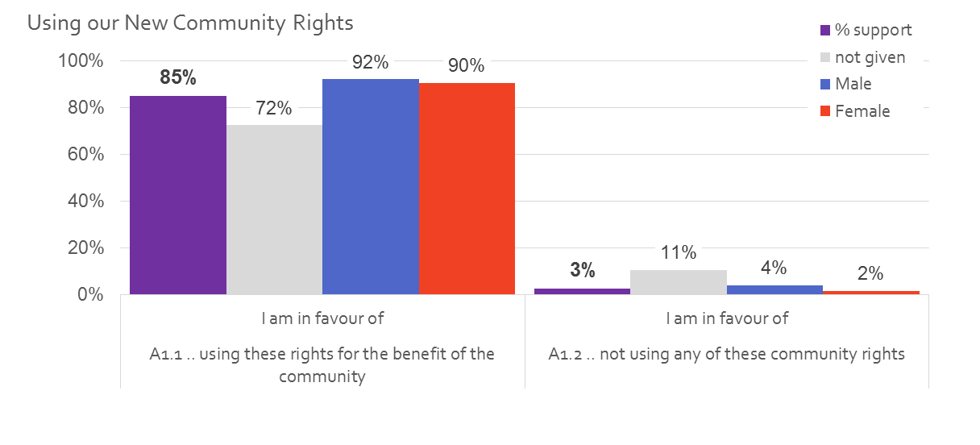
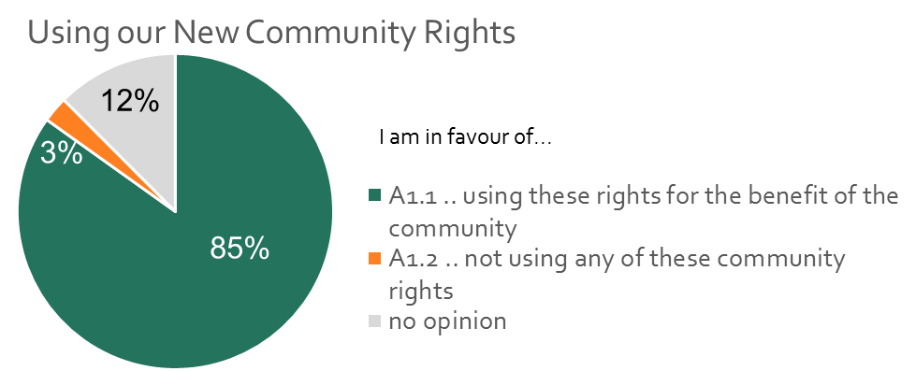
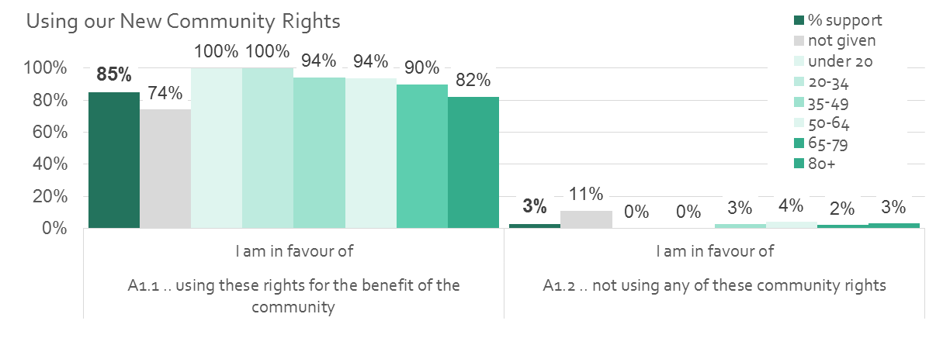
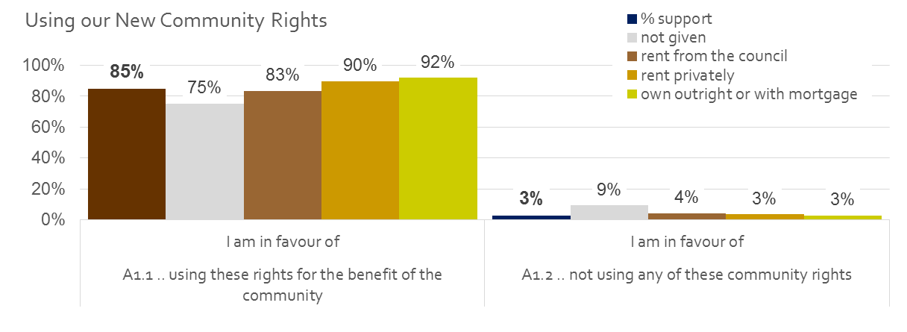
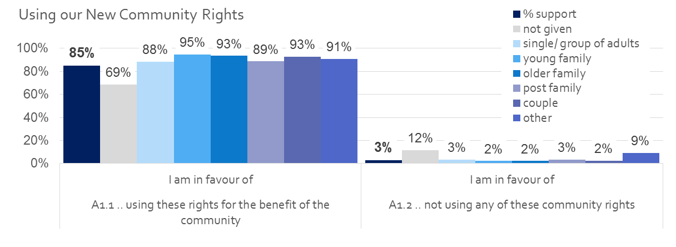
A1 Using our New Community Rights

Slide 5
How to use our Community Rights
We received more than 130 comments on how we might use our community rights
There are a great diversity of ideas
The most popular themes are:
  To develop community assets and facilities for youth and community use (33)
  To deal with Haslemere parking issues (33)

Slide 6
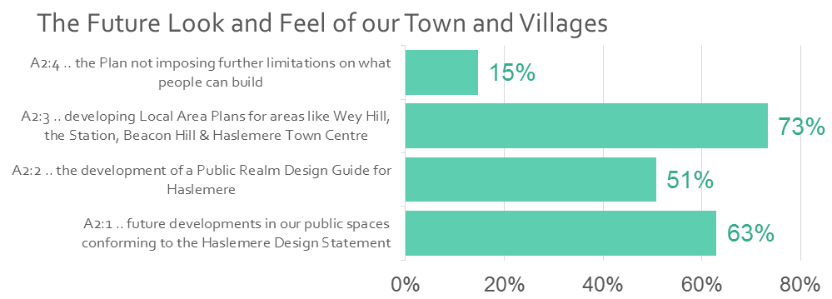
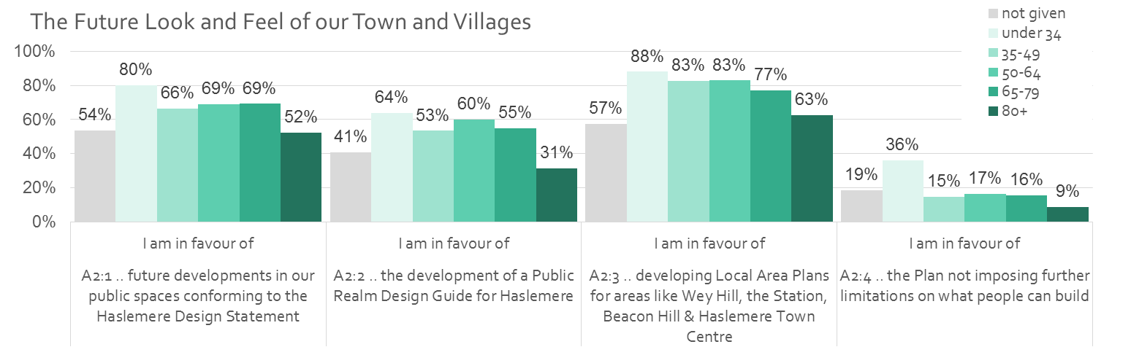
A2 The Future Look and Feel of our Town and Villages
Strongest support is for developing Local Area Plans and for the Haslemere Design Statement
Younger people are most in favour of the area plans

Slide 7
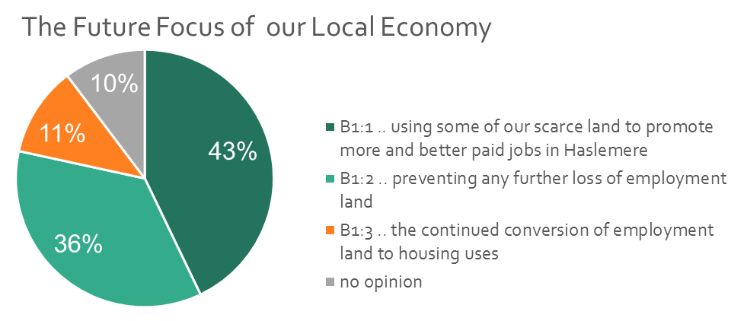
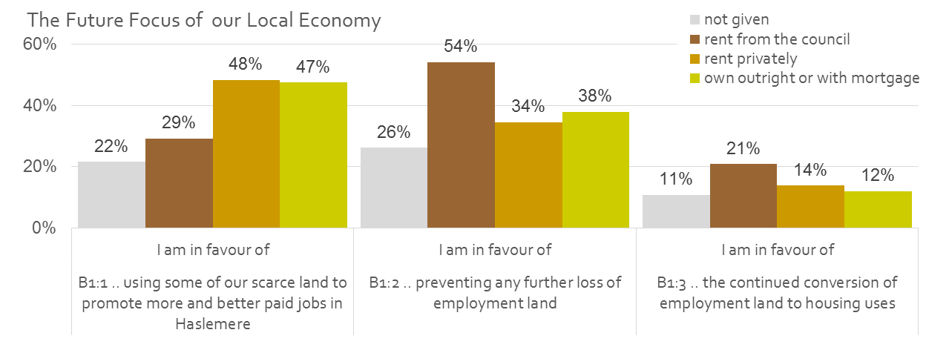
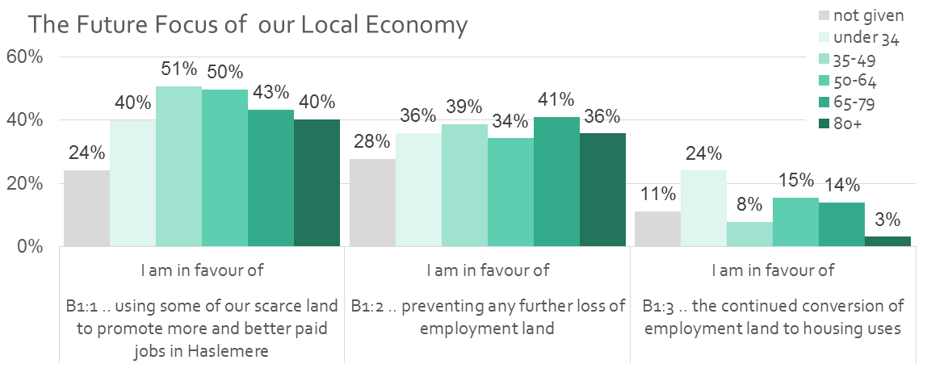
B1 The Future Focus of our Local Economy
79% of respondents favour protecting or increasing employment land uses in Haslemere
A proactive policy is most strongly supported by the 35-64 age bracket
Those in council accommodation want to prevent any further loss

Slide 8
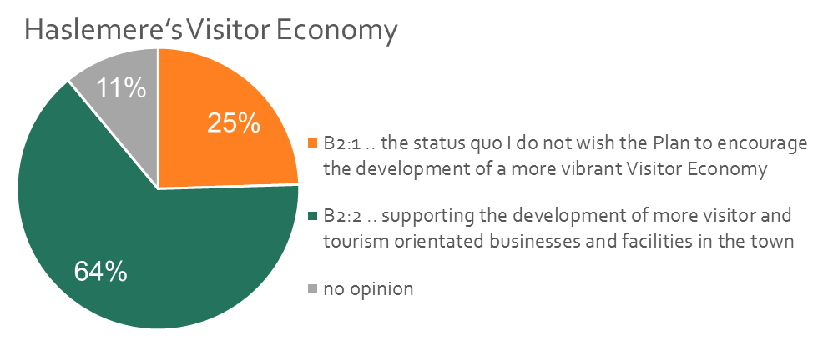
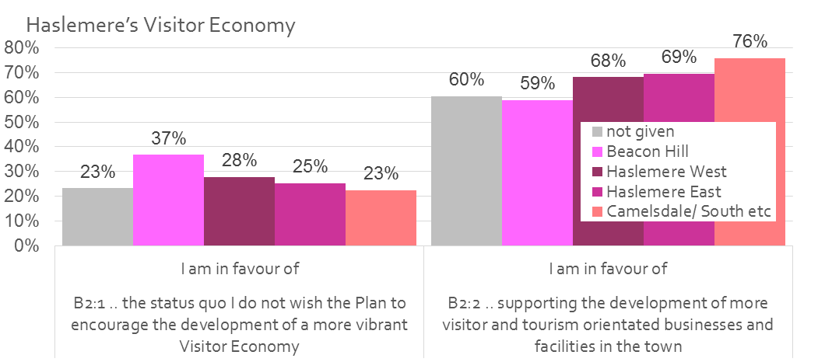
B2 Haslemere’s Visitor Economy
64% of respondents favour supporting the development of more visitor and tourism related business and facilities in the town
Beacon Hill residents are the least likely to be enthusiastic

Slide 9
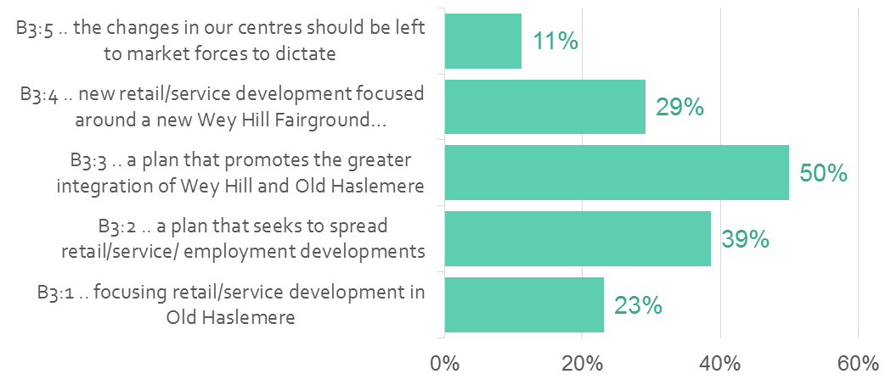
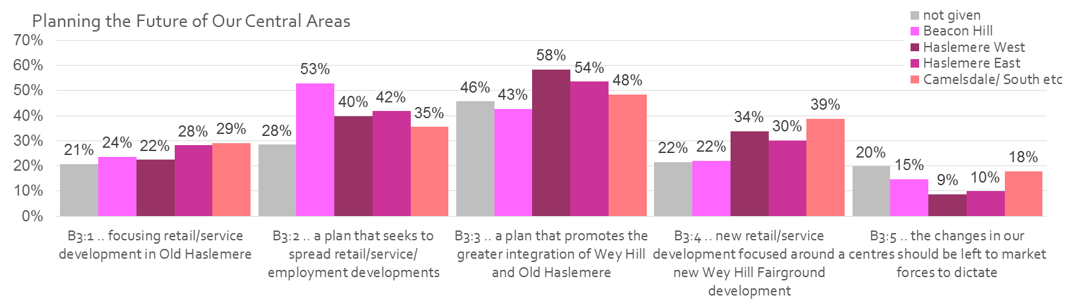
B3 Planning the Future of Our Central Areas
The clearly preferred option is development that promotes the integration of Wey Hill and Old Haslemere
Beacon Hill Residents are more in favour of spreading retail and employment
Those from Camelsdale and the South are the group most interested in Wey Hill (and those renting from the council)

Slide 10
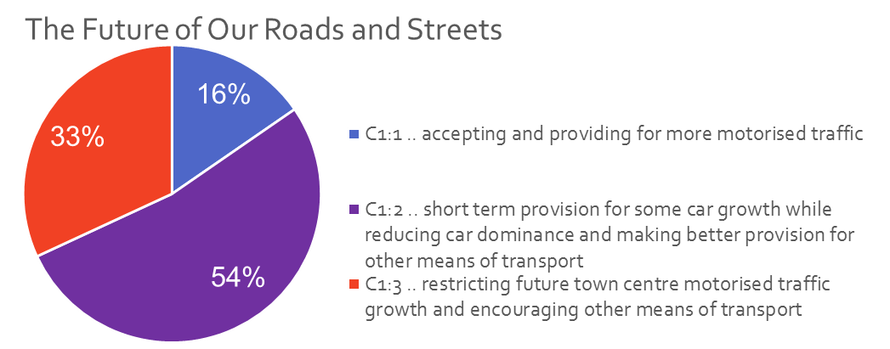
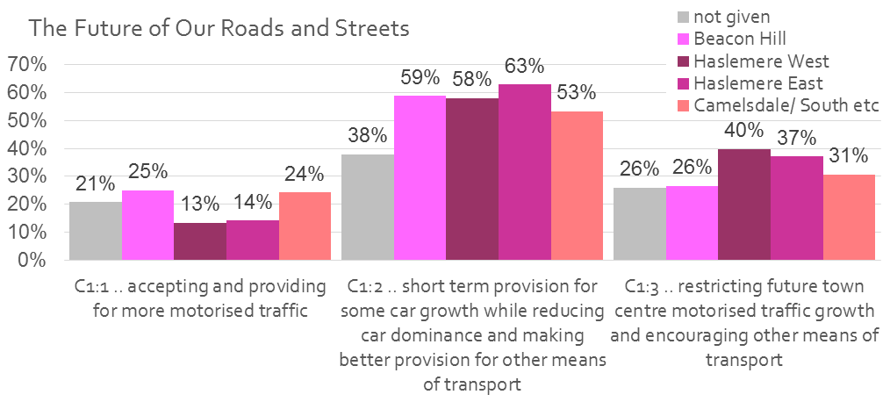
C1 The Future of Our Roads
The largest group of residents favour a balanced approach
  Making short term provision for some car growth but
  Seeking ways to reduce car dominance and improving public transport

Slide 11
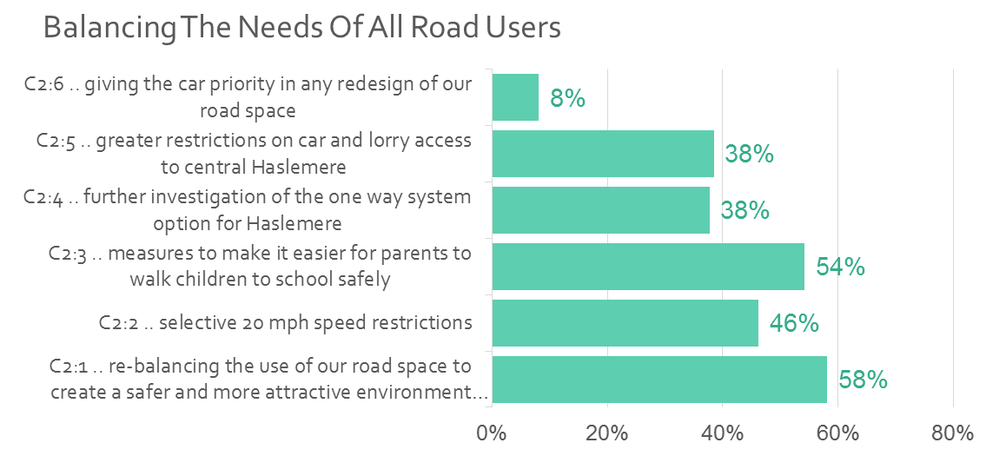
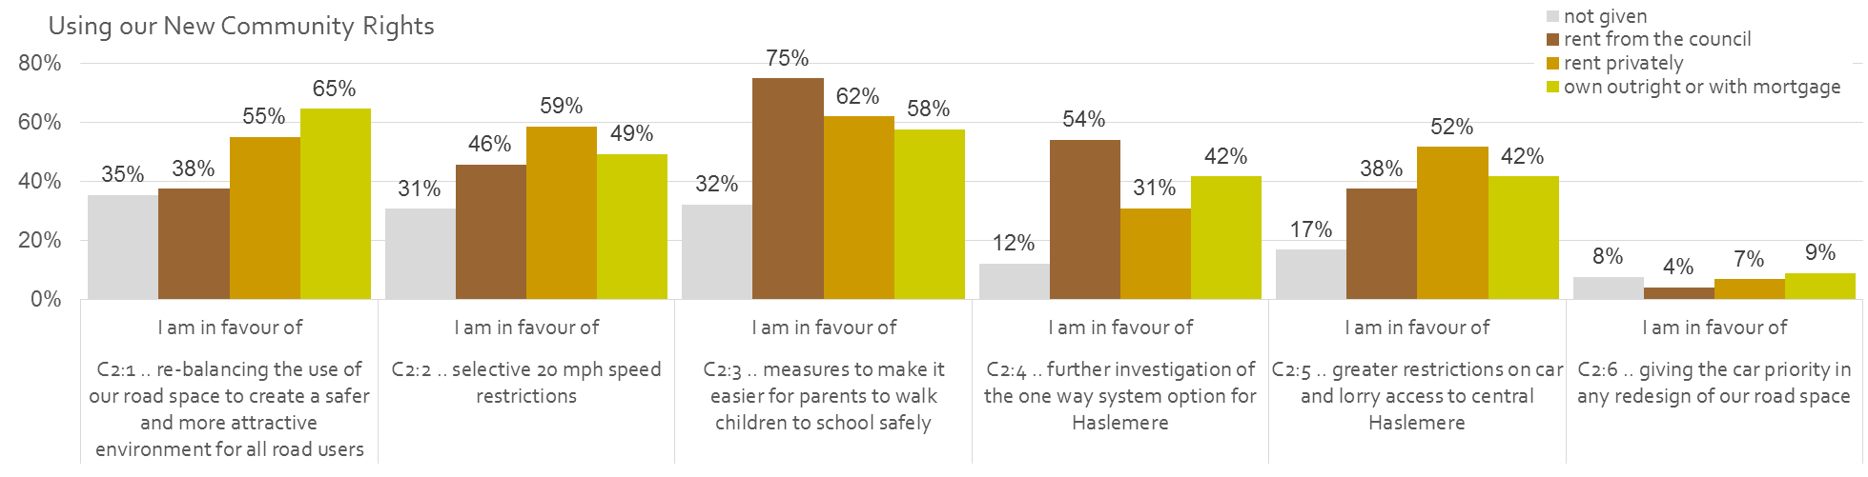
C2 Balancing the Needs of All Road Users
The most popular option among all residents is to re-balance the use of our road space to create a safer and more attractive environment.
Measures to make it safer for parents to walk children to school are also popular especially among those living in council accommodation

Slide 12
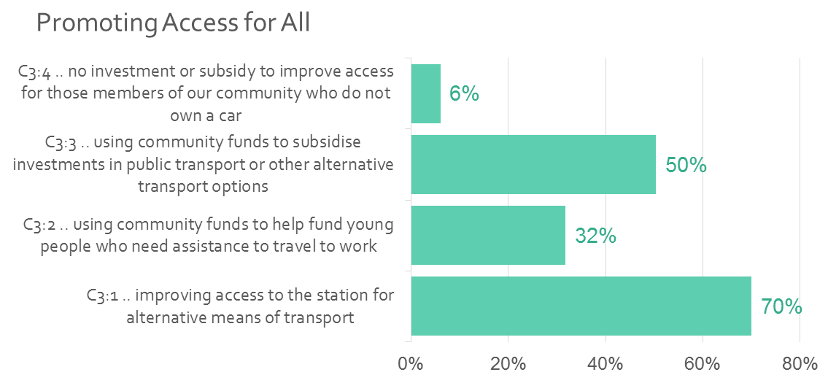
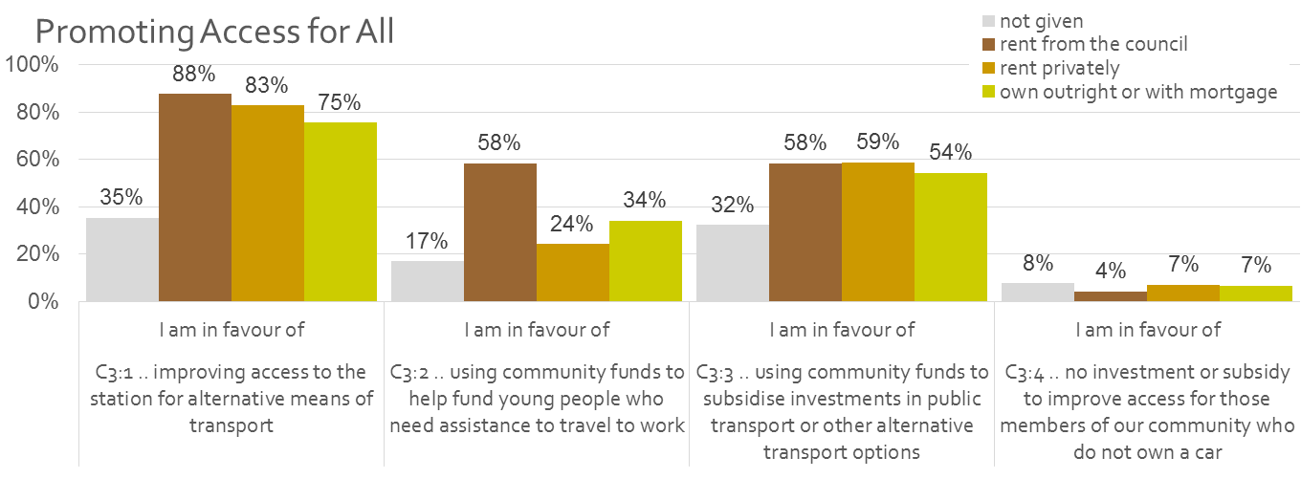
C3 Promoting Access for All
Improving alternative transport access to the station gains strong support from all groups
Using community funds to give assistance to young people needing help to travel to work is most popular among those living in council properties

Slide 13
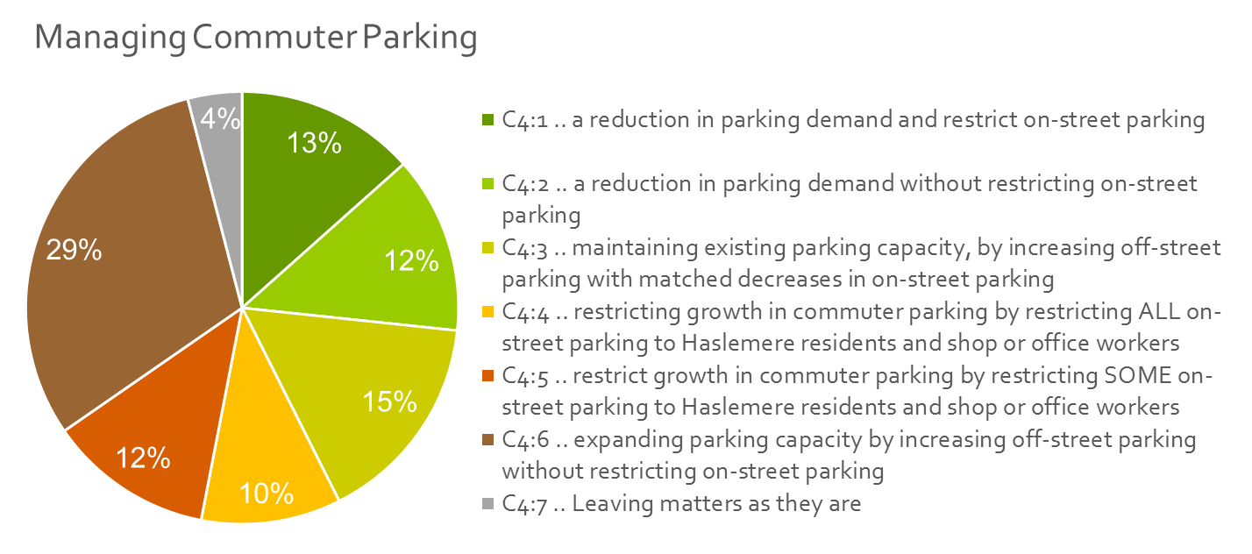
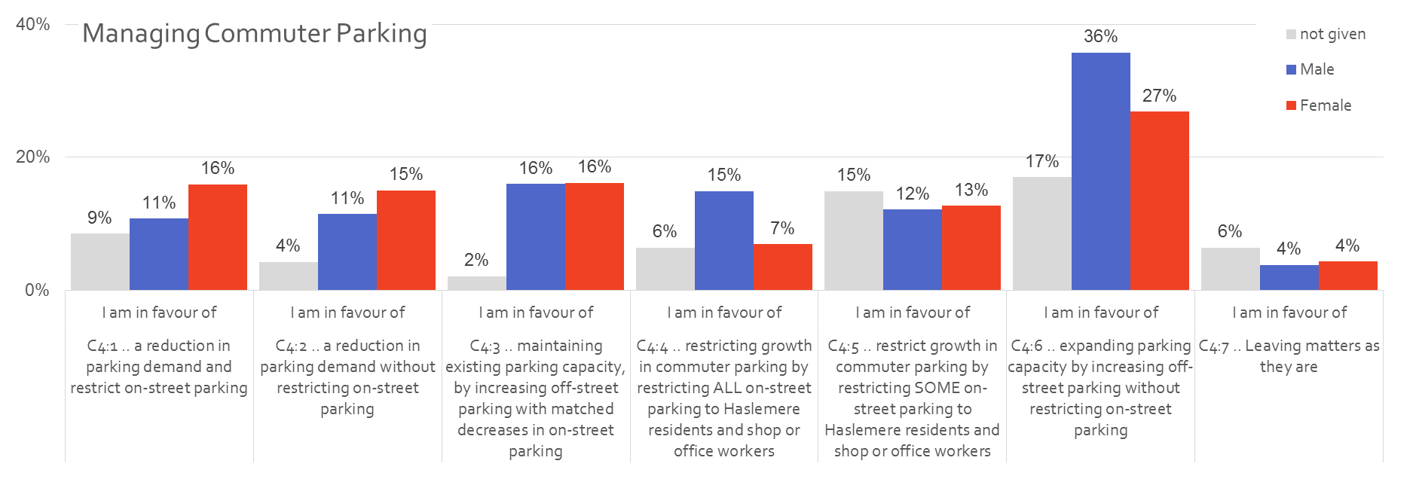
C4 Managing Commuter Parking
The most popular option expands off street parking – without restricting on street parking.
C4.3 was the 2nd most popular option also favouring more off street parking
However, the two options seeking to restrict parking demand when combined are more popular among women

Slide 14
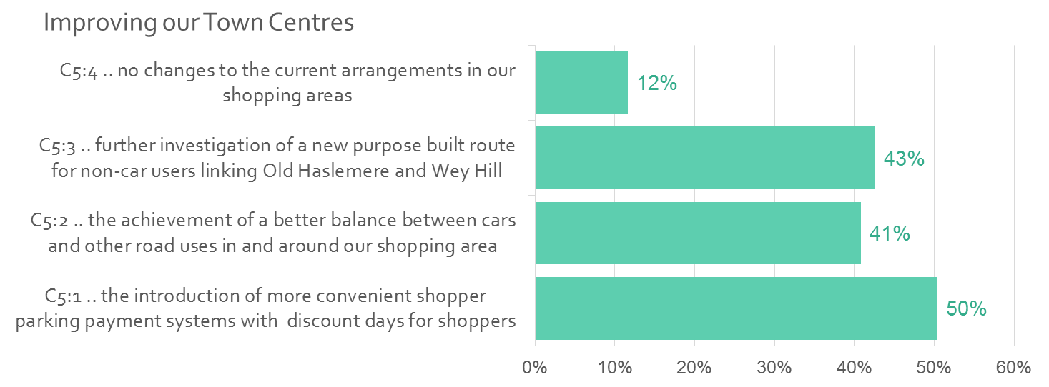
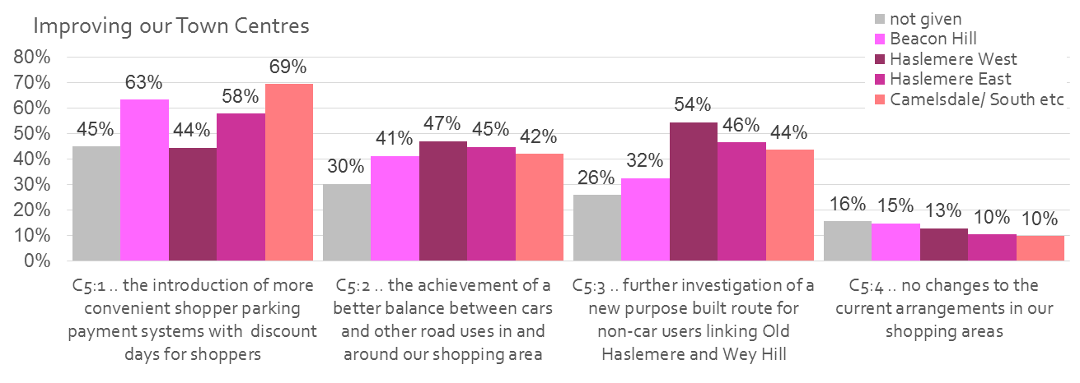
C5 Improving our Town Centre
The most popular option for all but Haslemere West residents is more convenient shopper parking
More Haslemere West residents are in favour of a new non car link between Wey Hill and Old Haslemere

Slide 15
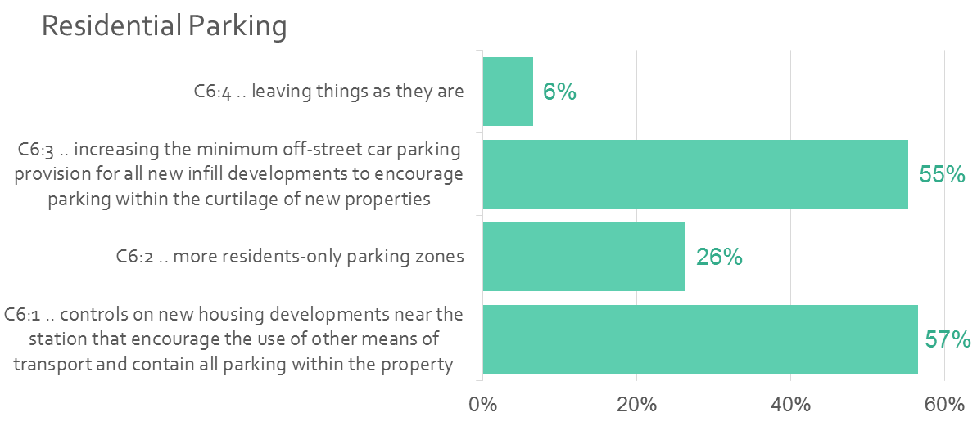
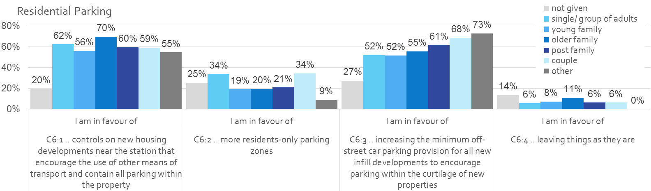
C6 Residential Parking
Residents want to ensure new developments are built with enough parking within the curtilage of the property to prevent overspill onto the street
However they chose potentially conflicting policies to increase minimum parking provision and development that encourages other means of transport

Slide 16
Next Steps
We will be forming 4 Policy Development Groups to look at how we can develop the preferred options into ‘Neighbourhood Policies’ or ‘Vision Goals’
  Community Development
  Economy
  Transport
  Street Scape
The Phase 2 Consultation Preparation is already underway and will focus on:
  Housing numbers, location and type of development
  The nature of housing development and ‘built form’
  Wey Hill Area Options
  Beacon Hill Area Options
Date will be publicised to discuss all these issues and anyone wishing to get further involved in any of these groups should let Stewart Brown know by email at stewart@stewartmbrown.co.uk by Tuesday 30th September 2014

